Slide 1
PHYS4260 Quantum Mechanics II Spring 2025
Time-Independent Perturbation Theory

Slide 2
Outline
Good States: Recap
Good States: Theorem
Good States: Example
TEST 1 preparation problems

Slide 3
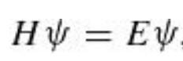
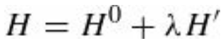
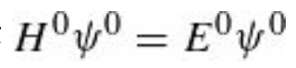
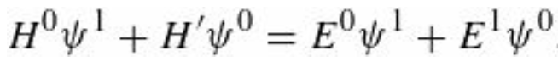
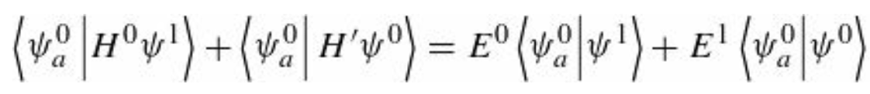
Re: Two-Fold Degeneracy: finding the good states
For the moment let’s just write the “good” unperturbed states in generic form keeping $α$ and $β$ adjustable. We want to solve the Schrödinger equation,
with and
Plugging these into the above Equation, and collecting powers of $λ$ (as before) we find
the first terms cancel; at order $λ^{1}$ we obtain
Taking the inner product with $ψ_{a}^{0}$ on the left, we get

Slide 4
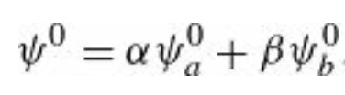
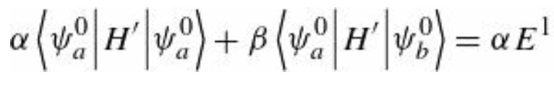
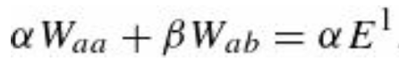
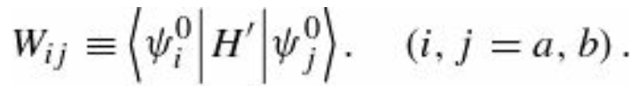
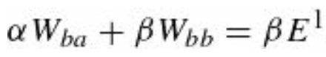
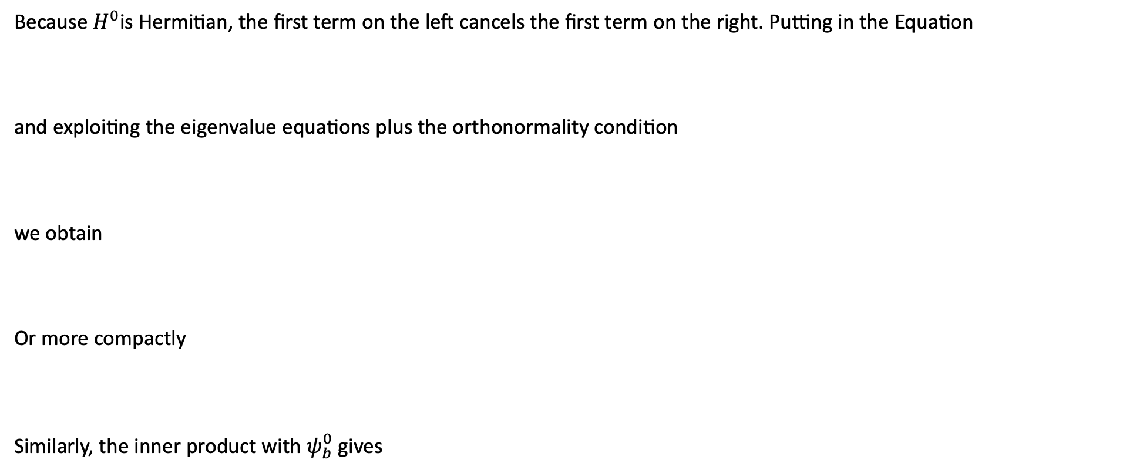
Re: Two-Fold Degeneracy: finding the good states
Because $H^{0}$is Hermitian, the first term on the left cancels the first term on the right. Putting in the Equation
and exploiting the eigenvalue equations plus the orthonormality condition
we obtain
Or more compactly
Similarly, the inner product with $ψ_{b}^{0}$ gives
and we have a system of equations.

Slide 5
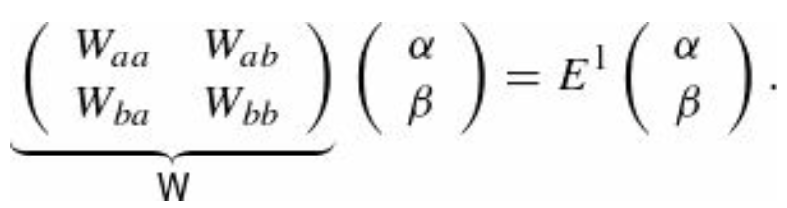
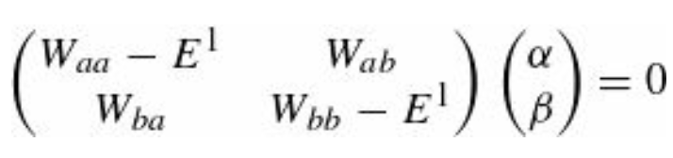
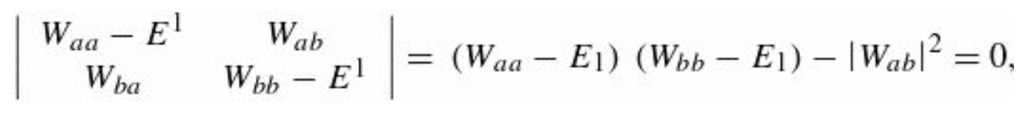
Re: Two-Fold Degeneracy: finding the good states
Notice that the Ws are (in principle) known—they are just the “matrix elements” of $H^{′}$ with respect to the unperturbed wave functions $ψ_{a}^{0}$ and $ψ_{b}^{0}.$ $\text{Written} \text{in} \text{matrix} \text{form}\text{, }\text{the} \text{previous} \text{e}\text{quations}$read
The eigenvalues of the matrix $W$ give the first-order corrections to the energy $E^{1}$ and the corresponding eigenvectors tell us the coefficients α and β that determine the “good” states. To obtain the eigenvalues of $W$ we proceed as follows
This equation only has non-trivial solutions if the matrix on the left is non-invertible, i.e., if its determinant vanishes:

Slide 6
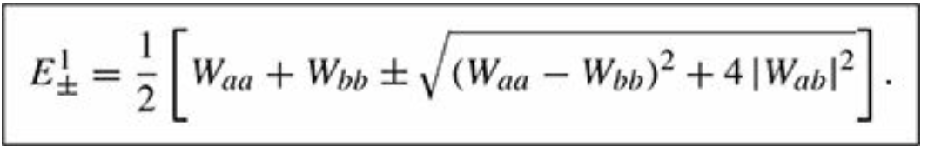
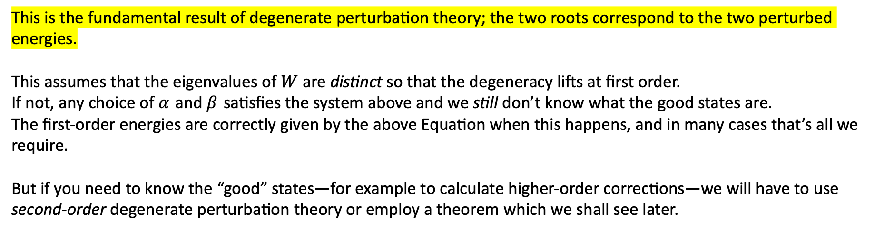
Re: Two-Fold Degeneracy: finding the good states
Solving the quadratic for the energy $E1$, one obtains
This is the fundamental result of degenerate perturbation theory; the two roots correspond to the two perturbed energies.
This assumes that the eigenvalues of $W$ are distinct so that the degeneracy lifts at first order.
If not, any choice of $α$ and $β$ satisfies the system above and we still don’t know what the good states are.
The first-order energies are correctly given by the above Equation when this happens, and in many cases that’s all we require.
But if you need to know the “good” states—for example to calculate higher-order corrections—we will have to use second-order degenerate perturbation theory or employ a theorem which we shall see later.

Slide 7
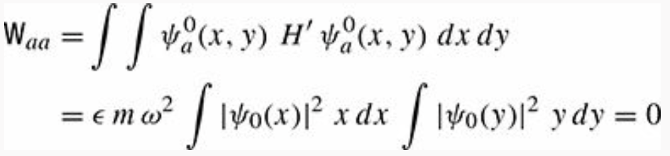
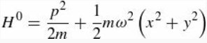
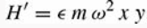
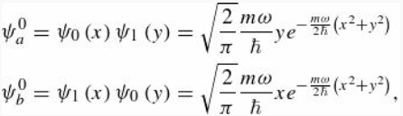
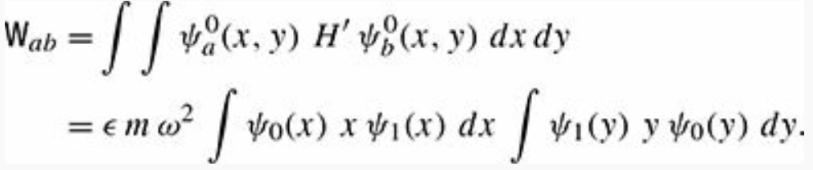

Finding the good states: Example
Let’s consider again a particle of mass m in a two-dimensional oscillator potential as we did in the previous example.
One can show that diagonalizing the matrix $W$ gives the same “good” states we found by solving the problem exactly.
The first step to show this, is to calculate the matrix elements of $W$
Recap box
as the integrands are both odd functions. Similarly, $W_{bb}=0$, and we are left with

Slide 8
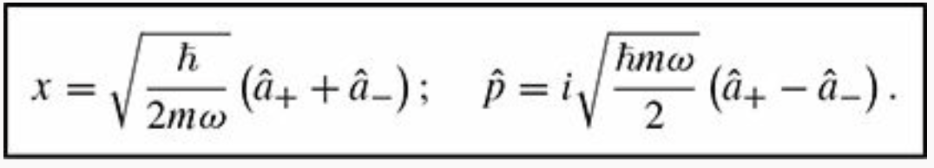
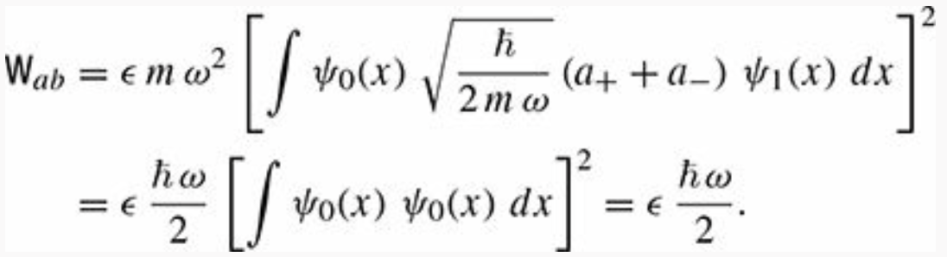
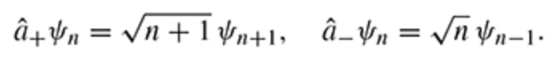
Finding the good states: Example
These two integrals are equal, and recalling the relations
one obtains
where we used , and the orthonormality of the wave functions.

Slide 9
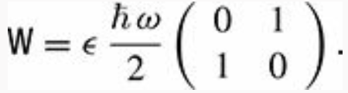
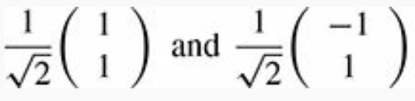
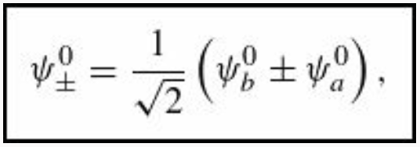
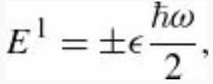

Finding the good states: Example
Finally, we obtain that W is
The (normalized) eigenvectors of this matrix are
These eigenvectors tell us which linear combination of functions $ψ_{a}^{0}$ and $ψ_{b}^{0}$ are the good states:
exactly as we have found before. The eigenvalues of the matrix $W$ are
and give the first-order corrections to the energy.

Slide 10
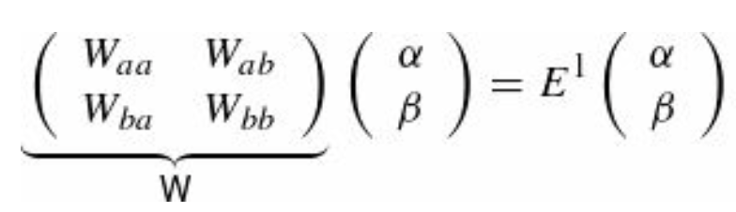
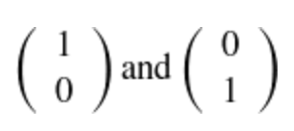
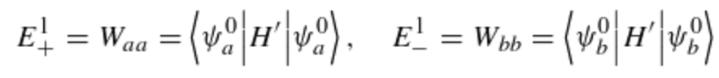

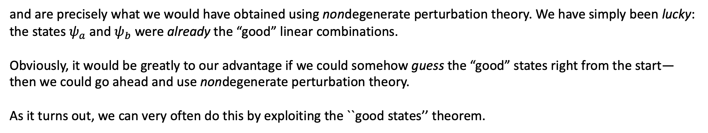
Finding the good states
If it happens that $W_{ab}=0$ in the $W$ matrix, then the
eigenvectors are
and the energies are given by
and are precisely what we would have obtained using nondegenerate perturbation theory. We have simply been lucky: the states $ψ_{a}$ and $ψ_{b}$ were already the “good” linear combinations.
Obviously, it would be greatly to our advantage if we could somehow guess the “good” states right from the start—then we could go ahead and use nondegenerate perturbation theory.
As it turns out, we can very often do this by exploiting the ``good states’’ theorem.

Slide 11
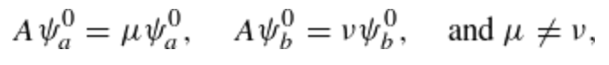
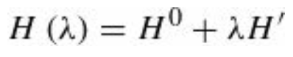
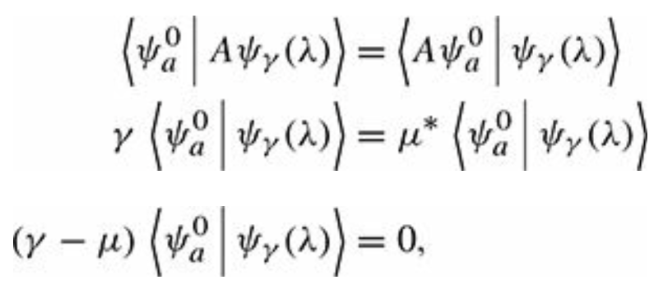
``Good states’’ theorem
Let A be a Hermitian operator that commutes with $H^{0}$ and $H^{′}$. If $ψ_{a}$ and $ψ_{b}$ (the degenerate eigenfunctions of $H^{0}$) are also eigenfunctions of A, with distinct eigenvalues,
Then $ψ_{a}$ and $ψ_{b}$ are the “good” states to use in perturbation theory.
PROOF
Since commutes with $A$, there exist simultaneous eigenstates $ψ_{γ}\left(λ\right)$ such that
The fact that A is Hermitian means
(making use of the fact that μ is real).

Slide 12
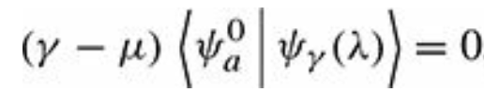
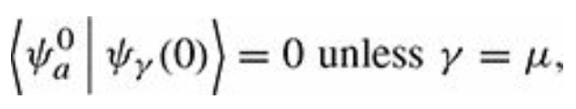
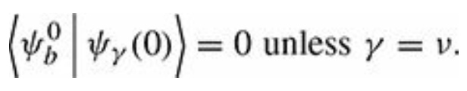
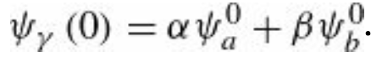
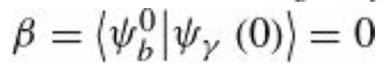


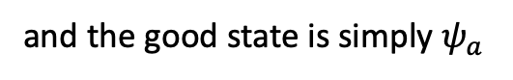
``Good states’’ theorem
PROOF cont’d
is true for every value of $λ$ and taking the limit $λ→0$, one obtains
and similarly
Now the good states are linear combinations of $ψ_{a}$ and $ψ_{b}$ From the eqns. above, it follows that
either $γ=μ$ in which case
and the good state is simply $ψ_{a}$
Or $γ=ν$ and the good state is simply $ψ_{b}$. Q.E.D.
Once we identify the “good” states, either by solving the eigenvalue Equation or by applying this theorem, we can use these “good” states as our unperturbed states and apply ordinary non-degenerate perturbation theory.
In most cases, the operator $A$ will be suggested by symmetry. Symmetries are associated with operators that commute with $H$ precisely what are required to identify the good states.

Slide 13
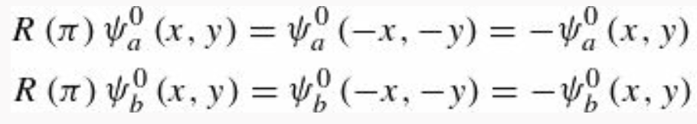
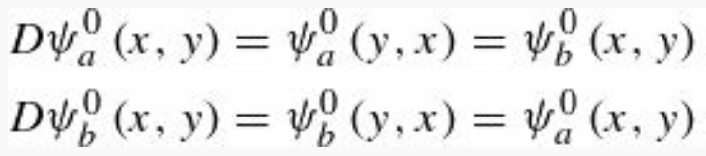
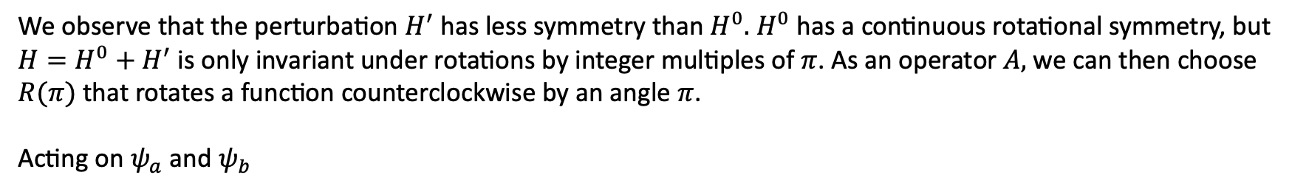
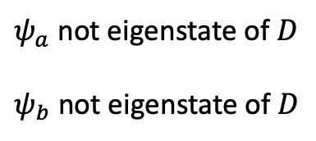
``Good states’’ theorem: Application
Let’s find an operator $A$ that satisfies the requirements of the ``good’’ states theorem to construct the “good” states in the
last two examples we have seen.
We observe that the perturbation $H^{′}$ has less symmetry than $H^{0}.$ $H^{0}$ has a continuous rotational symmetry, but
$H=H^{0}+H^{′}$ is only invariant under rotations by integer multiples of $π$. As an operator $A,$we can then choose
$R(π)$ that rotates a function counterclockwise by an angle $π$.
Acting on $ψ_{a}$ and $ψ_{b}$
That’s not good. We need an operator with distinct eigenvalues. How about the operator that interchanges x and y?
This is a reflection about a $π\text{/4}$ diagonal of the well. Call this operator $D.$ We have that $\left[H^{0}, D\right]=0$ and $\left[H^{′}, D\right]=0$
since they are unchanged when we switch x and y. Now,
$ψ_{a}$ not eigenstate of $D$
$ψ_{b}$ not eigenstate of $D$

Slide 14
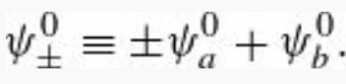
``Good states’’ theorem: Application
Therefore, our degenerate eigenstates are not eigenstates of $D$. But we can construct linear combinations that are:
Then
These are “good” states, since they are eigenstates of an operator with distinct eigenvalues $±1$ and $D$ commutes with $H^{0}$ and $H^{′}$.
Moral: If you’re faced with degenerate states, look around for some Hermitian operator $A$ that commutes with $H^{0}$ and $H^{′}$.
Pick as your unperturbed states ones that are simultaneously eigenfunctions of $H^{0}$ and $A$ (with distinct eigenvalues). Then use ordinary first-order perturbation theory. If you can’t find such an operator, we’ll have to resort to the eigenvalue equation, but in practice this is seldom necessary.

Slide 15

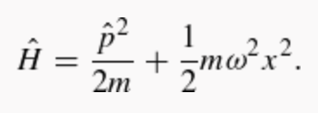
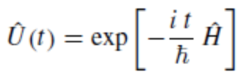
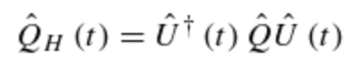
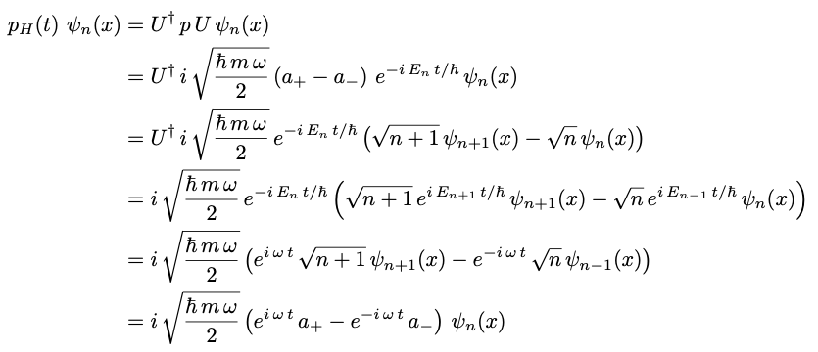





Preparation for TEST1: Problem 1, Ch 6
We have a particle of mass m moving a region of space where there is the simple harmonic motion potential
All we need is to work out the relation on $ψ_{n}$ with
$$−1$$
$$−1$$

Slide 16

Preparation for TEST1: Problem 1
Finally, we arrive at:
We find that
This is identical to the solution of the classical equations of motion with the classical variables
$x$ and $p$ replaced by the quantum operators $x_{H}$ and $p_{H}$.

Slide 17


Preparation for TEST1: Problem 2, Ch 7

Slide 18





Preparation for TEST1: Problem 2
A) To calculate the energies as a power series with $ε$ as the small parameter, we simply Taylor expand the full expression
B) Here we need to calculate
We observe that
with $⟨n|V|n⟩$the expectation value of the (unperturbed) potential energy in the n-th unperturbed state.
We can proceed two ways here, to calculate $\left\langle n\left|V\right|n\right\rangle :$
1.

Slide 19




Preparation for TEST1: Problem 2
Then, the integral for the expectation value becomes
Now we observe that $({\hat{a}}_{+}{{\hat{a}}_{+}) ψ}_{n}={A ψ}_{n+2}$ where A is a normalization factor. This is orthogonal to ${ ψ}_{n}$
T$he same holds for ({\hat{a}}_{−}{{\hat{a}}_{−}) ψ}_{n}={A′ ψ}_{n−2}$where A’ is another normalization factor. This is also orthogonal to ${ ψ}_{n}.$
Then using the relations
one easily finds that
And therefore

Slide 20









Preparation for TEST1: Problem 2
2.
The second method is more elegant and relies on the Generalized Ehrenfest relation
$H = T + V$ and we can show that
with
In fact,
For the harmonic oscillator:
Now we can use this result to simplify our calculation: $\left\langle T\right\rangle =\left\langle V\right\rangle$ $→\left\langle T\right\rangle +\left\langle V\right\rangle =E_{n}^{0}$ and it is trivial now to see that
$\left\langle V\right\rangle =\frac{E_{n}^{0}}{2}=1/2(n+1/2)ℏω$ which gives

Slide 21




Preparation for TEST1: Problem 3
Solution for the TISE
Unperturbed energies
From the notes (Jan 23), the 1st order correction to the energy is given by
$${2V}_{0}$$
Now for the 1st excited state, we must consider all the (degenerate) combinations which have the same energy

Slide 22



Preparation for TEST1: Problem 3
To construct the W matrix, we consider all possible combinations. The diagonal elements are
The mixed elements are
Therefore, the W matrix is
The eigenvalues are obtained as
The 1-st order corrections to the energies are:

Slide 23
Preparation for TEST1: Problem 4
Calculate the Clebsch-Gordan Coefficients for $j1 = 1$and $j2 = 1$

